Slide 1
WELCOME

Slide 2
INTRODUCTION
The Café Billing System is a comprehensive software solution designed to streamline and optimize the billing processes within a café environment.
This system is tailored to meet the specific needs of cafes, addressing challenges related to order management, menu customization, and payment processing. By leveraging advanced technology, the Cafe Billing System aims to enhance the overall efficiency of cafe operations, providing a user-friendly platform for both customers and staff.
From multilingual interfaces to robust reporting features, this system is crafted to offer a seamless and secure billing experience, contributing to improved customer satisfaction and operational effectiveness in the dynamic world of cafe management

Slide 3
Objectives
1. Efficient Order Management:
Streamline the order-taking process to reduce waiting times and enhance overall service efficiency.
2. Multilingual Support:
Implement a user-friendly interface with multilingual capabilities to accommodate a diverse customer base and improve communication.
3. Menu Customization:
Allow cafe owners to easily customize and update their menus, ensuring accuracy in item descriptions and prices.
4. Integration with Point of Sale (POS):
Integrate seamlessly with POS systems for real-time synchronization of orders, inventory, and sales data, minimizing errors and delays.

Slide 4
Needs
1. Efficiency and Accuracy:
Streamlines the billing process, reducing manual errors in order taking, invoicing, and payment processing, leading to increased accuracy and efficiency.
2. Customer Satisfaction:
Enhances the overall customer experience by minimizing waiting times, providing clear and accurate billing information, and supporting diverse language preferences.
3. Operational Optimization:
Optimizes internal operations, allowing staff to focus on delivering quality service rather than managing complex billing tasks, ultimately improving workflow Efficiency.
4. Real-time Data Synchronization:
Integrates with Point of Sale (POS) systems to ensure real-time synchronization of orders, inventory, and sales data, providing up-to-date insights for informed decision- making.

Slide 5
HARDWARE
HARDWARE :
Hardware of Computer means all physical part consist of computer system
H/W consist of input devices , CPU & OUTPUT Devices. For This System
RAM | 4GB or Above
SSD | 256 GB
PROCESSOR | Intel I7

Slide 6
SOFTWARE
SOFTWARE :
“Eclipse” provides a graphical environment. We design forms & control
that become building block of our website. “Postgresql “ provides much facility to store our
data safely
Operating System | Ubuntu 22.04 and Above
Language | HTML,CSS,PHP
IDE | VS Code
Data Base | MY Sql
Server | Appache

Slide 7
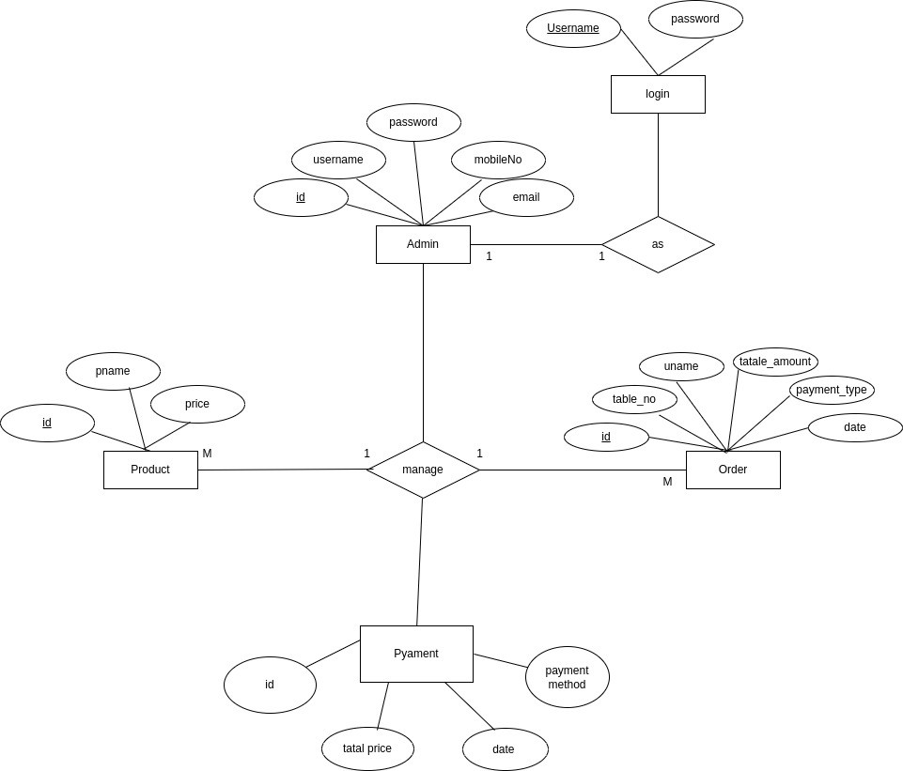
ER DIAGRAM

Slide 8
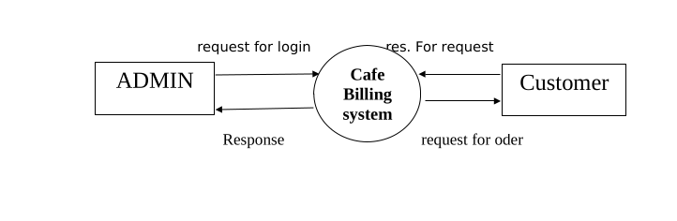
DATA FLOW DIGRAM
Level 0:

Slide 9
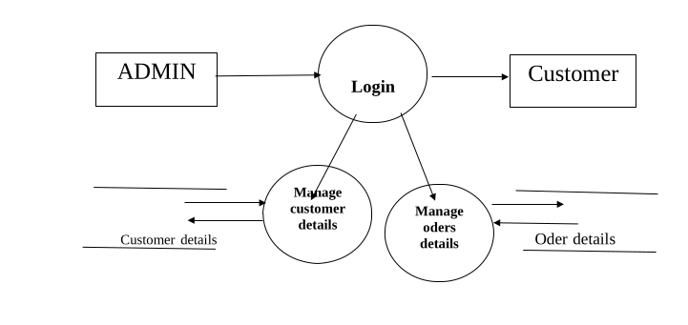
DATA FLOW DIGRAM
Level 1:

Slide 10
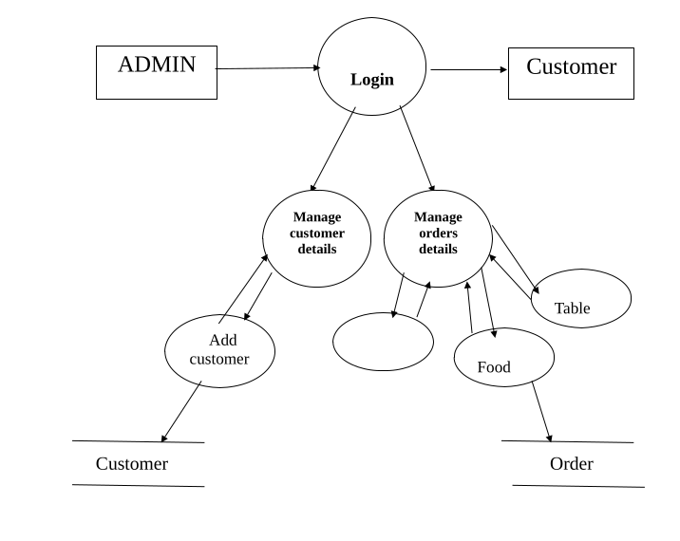
DATA FLOW DIGRAM
Level 2:

Slide 11
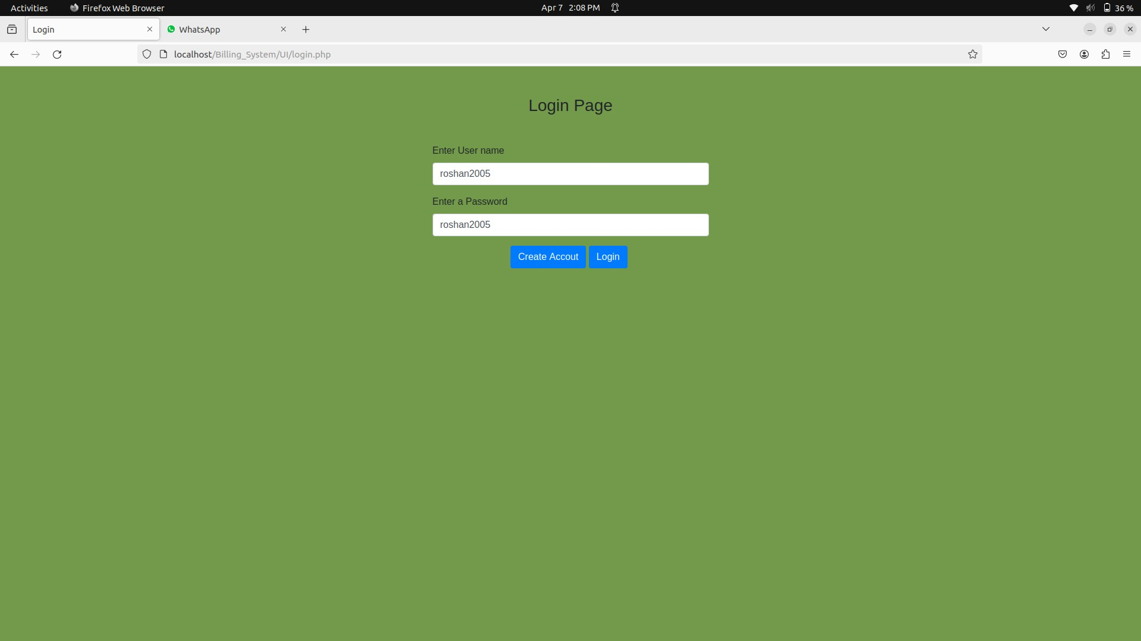
INPUTE & OUTPUTE SCREEN

Slide 12
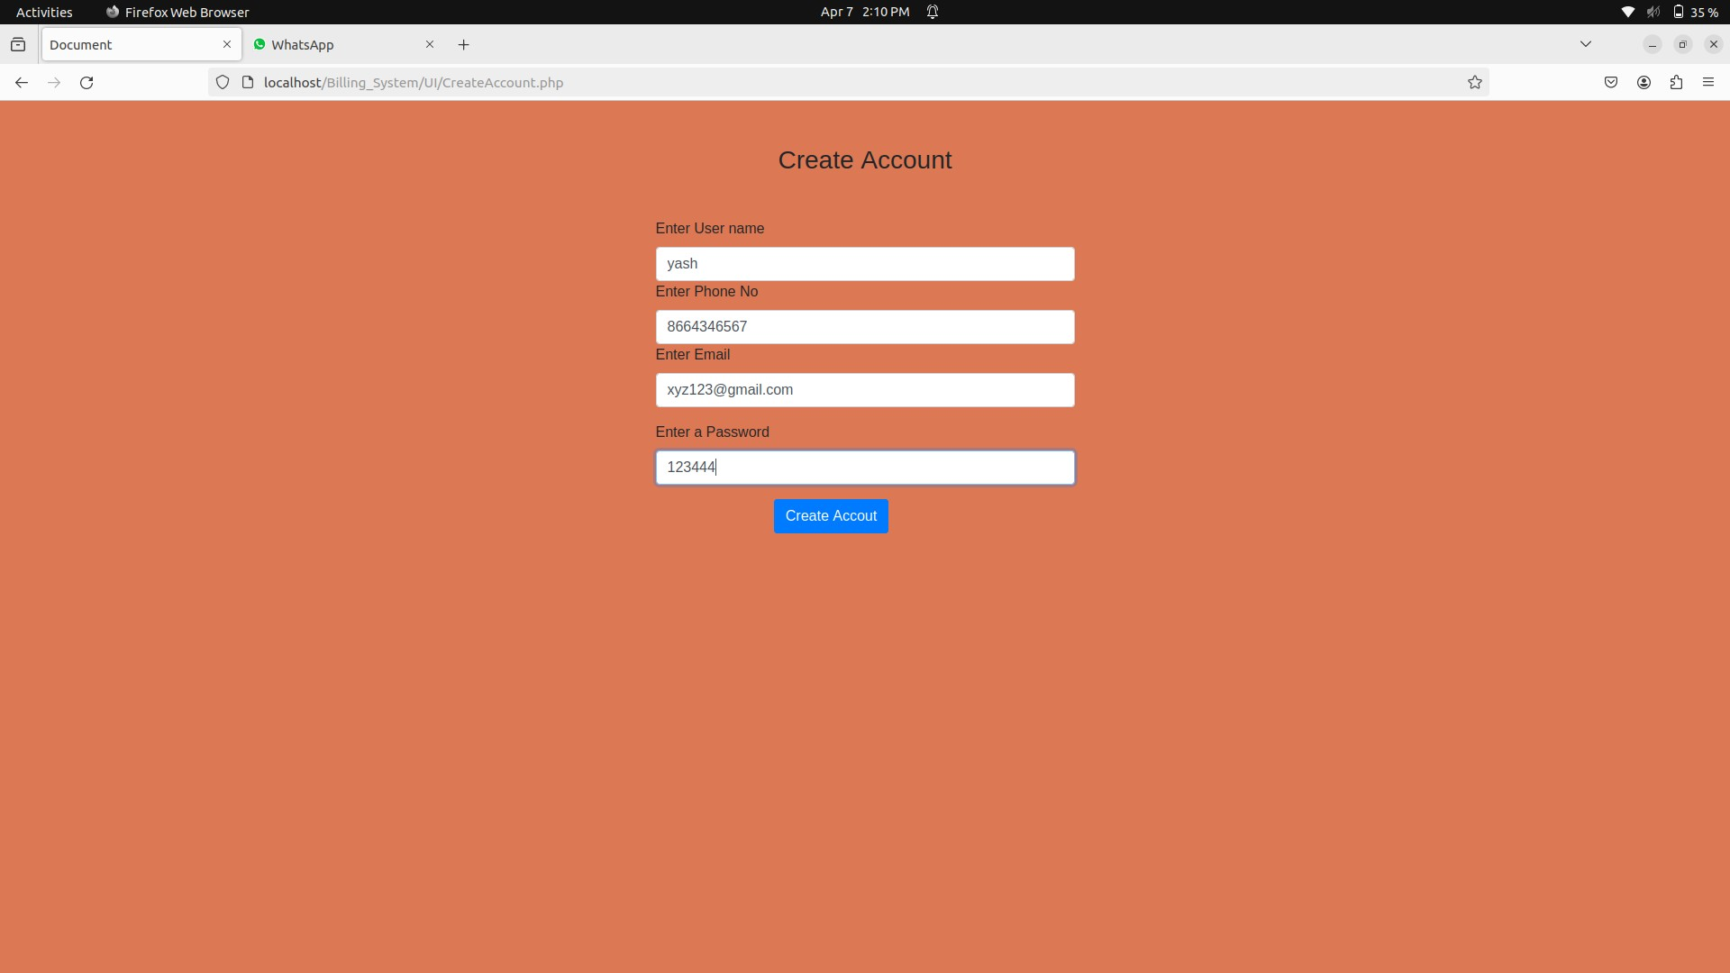
INPUTE & OUTPUTE SCREEN

Slide 13
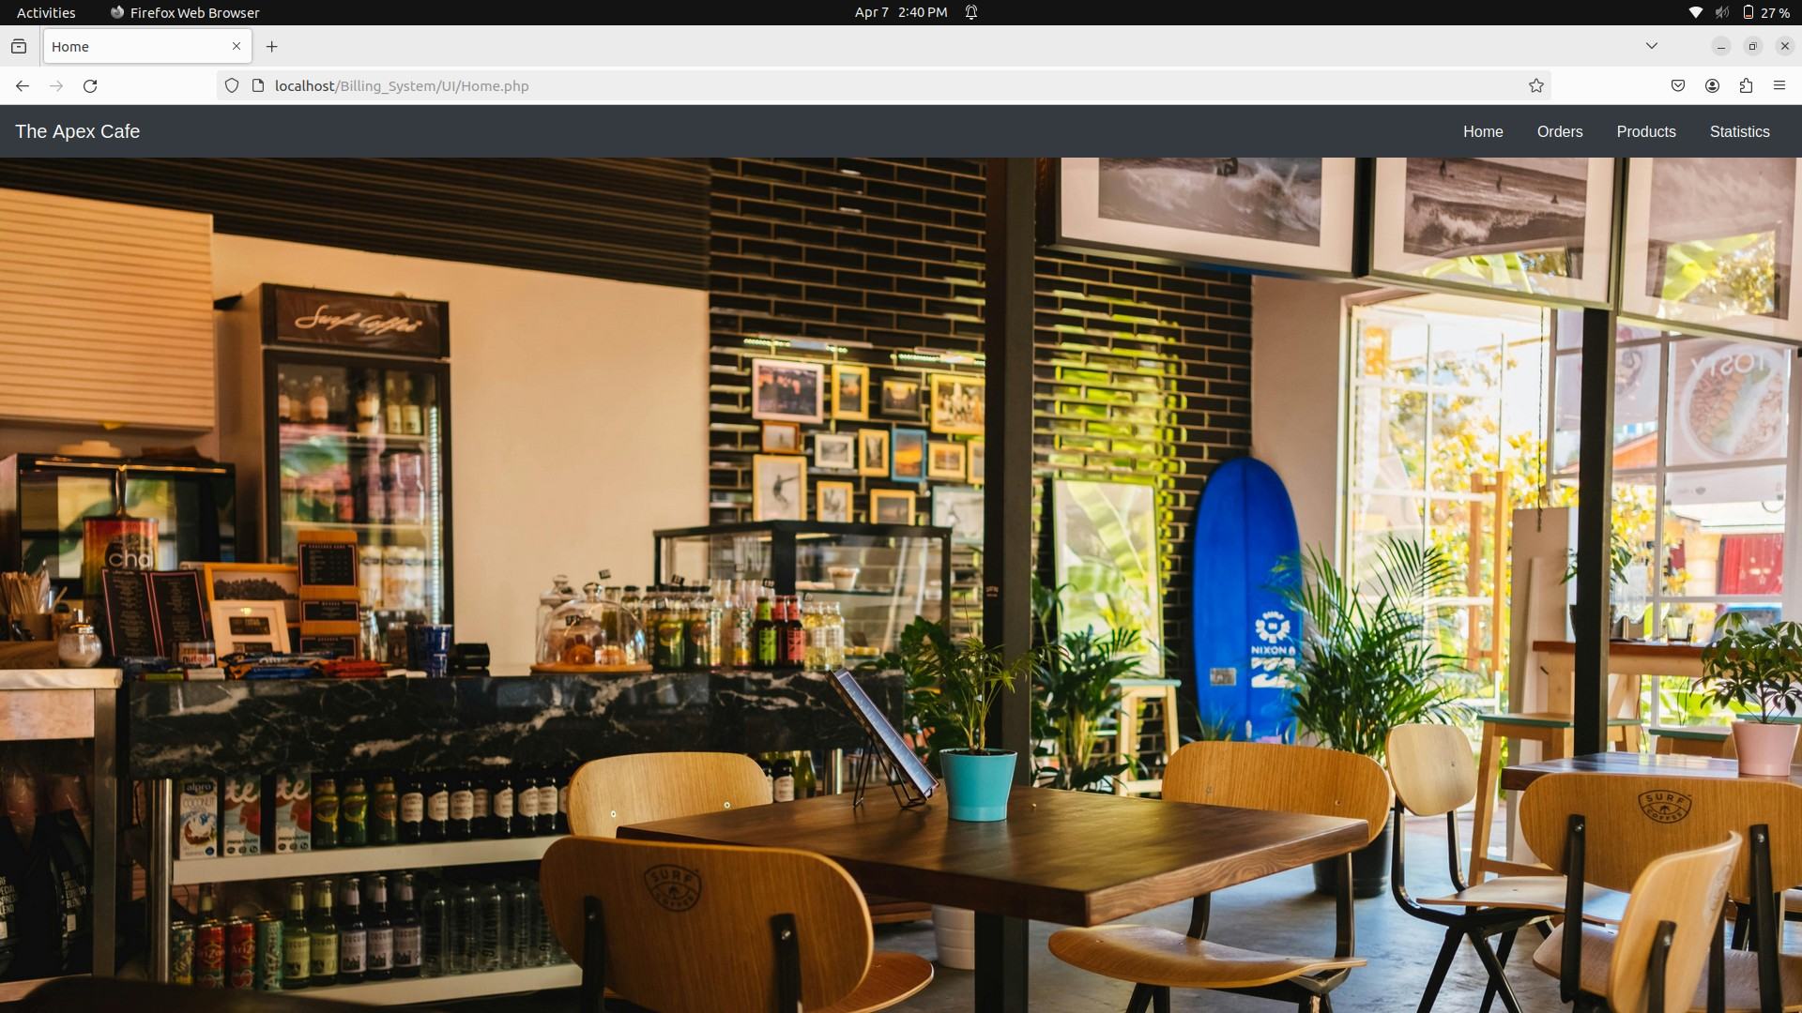
INPUTE & OUTPUTE SCREEN

Slide 14
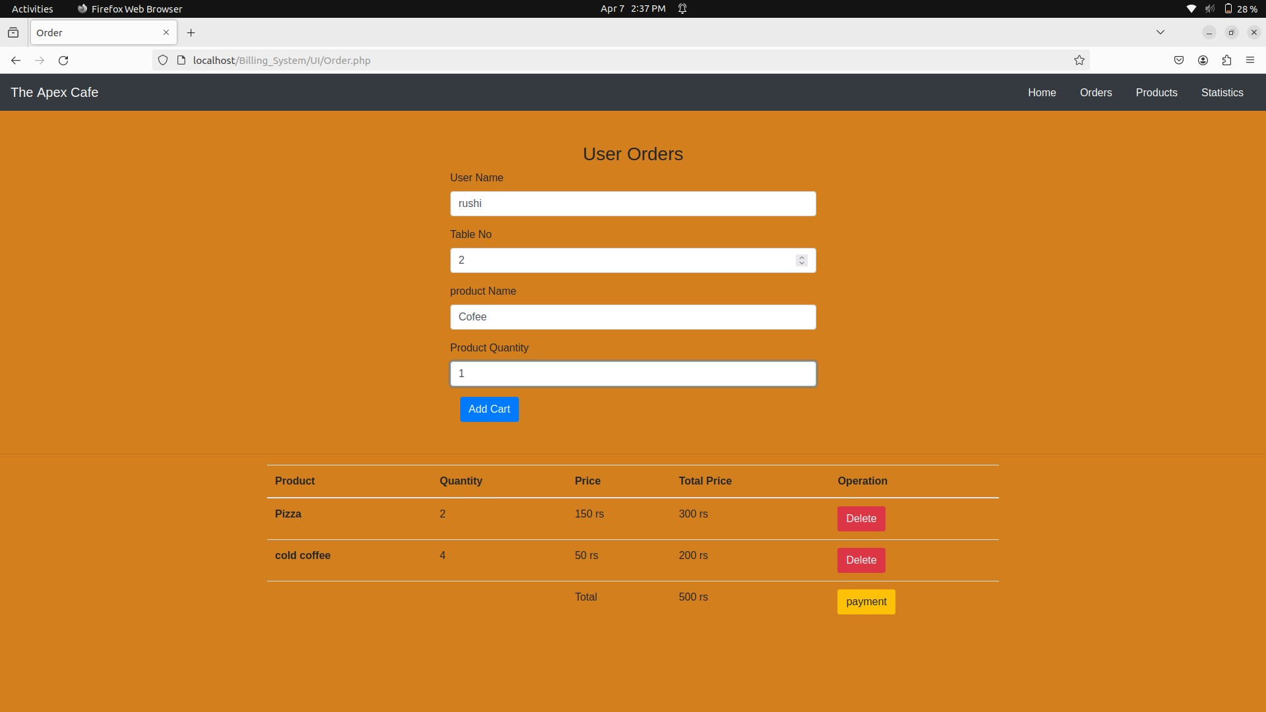
INPUTE & OUTPUTE SCREEN

Slide 15
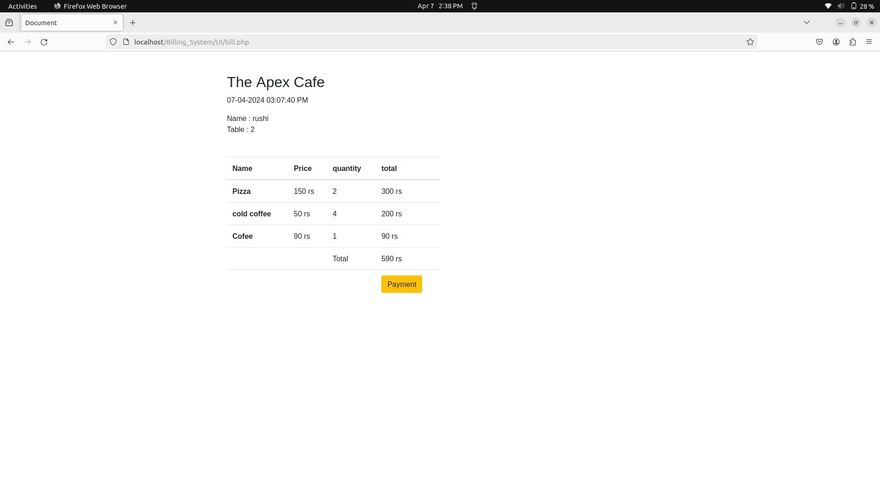
INPUTE & OUTPUTE SCREEN

Slide 16
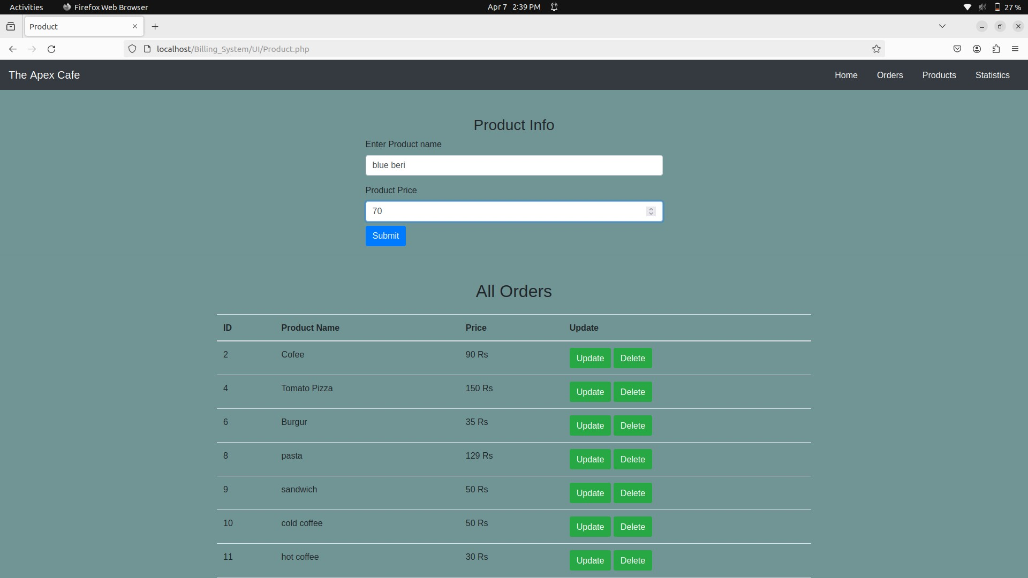
INPUTE & OUTPUTE SCREEN

Slide 17
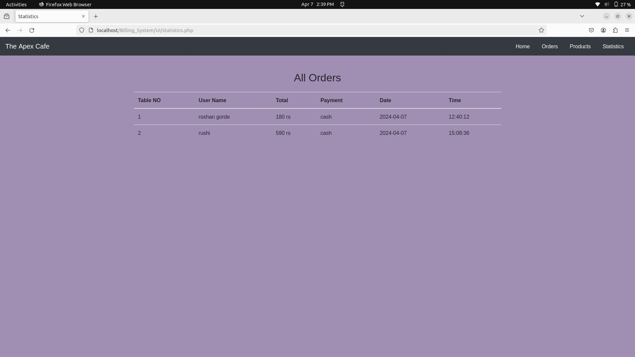
INPUTE & OUTPUTE SCREEN

Slide 18
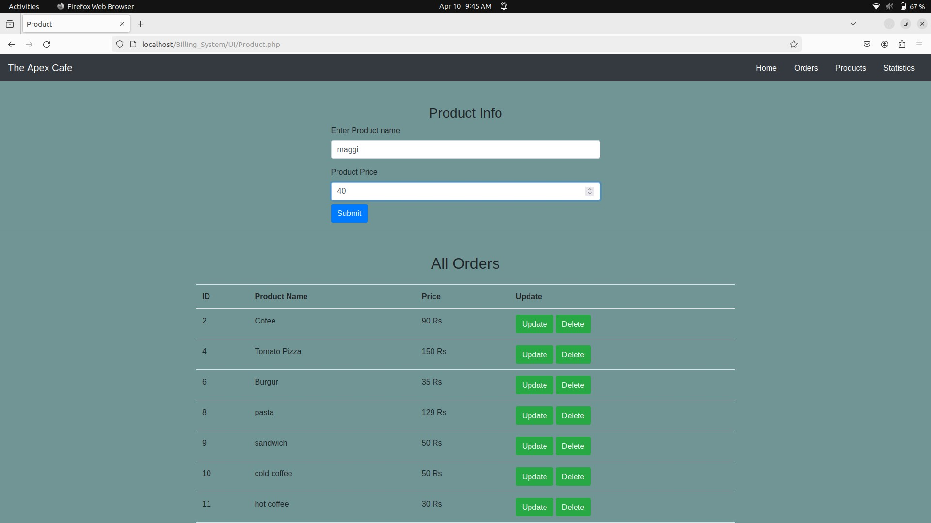
INPUTE & OUTPUTE SCREEN

Slide 19
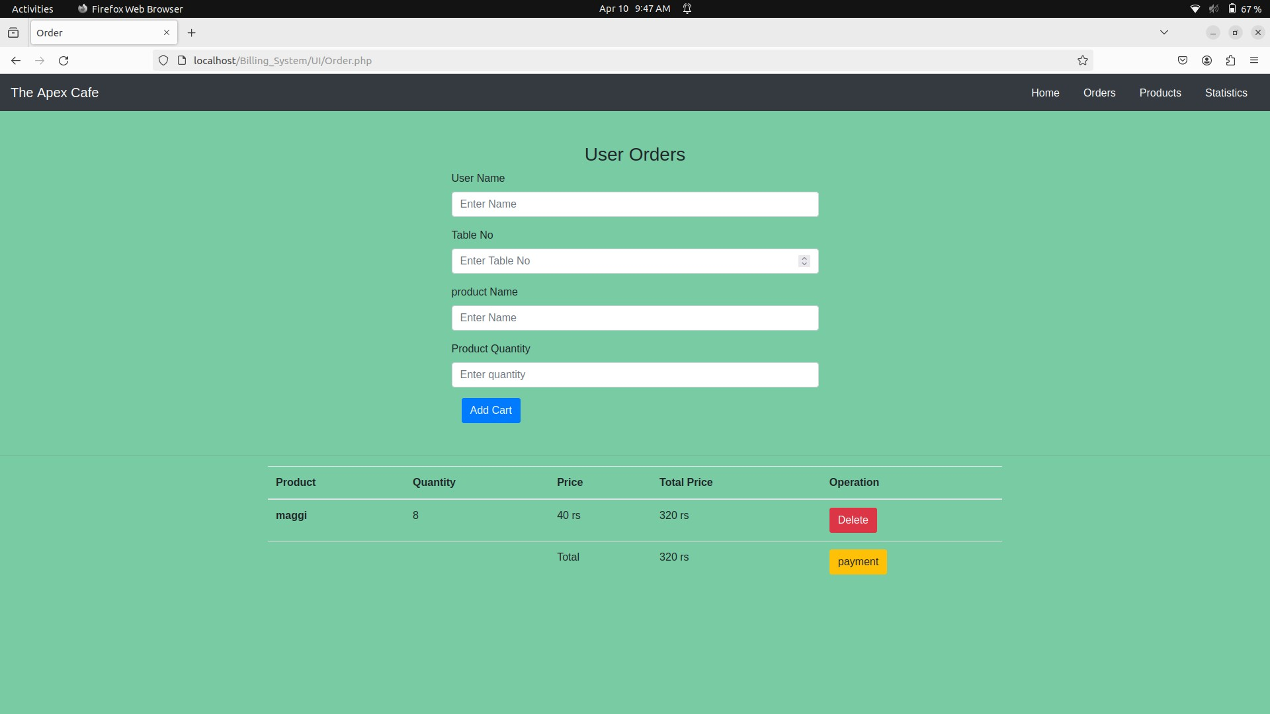
INPUTE & OUTPUTE SCREEN

Slide 20
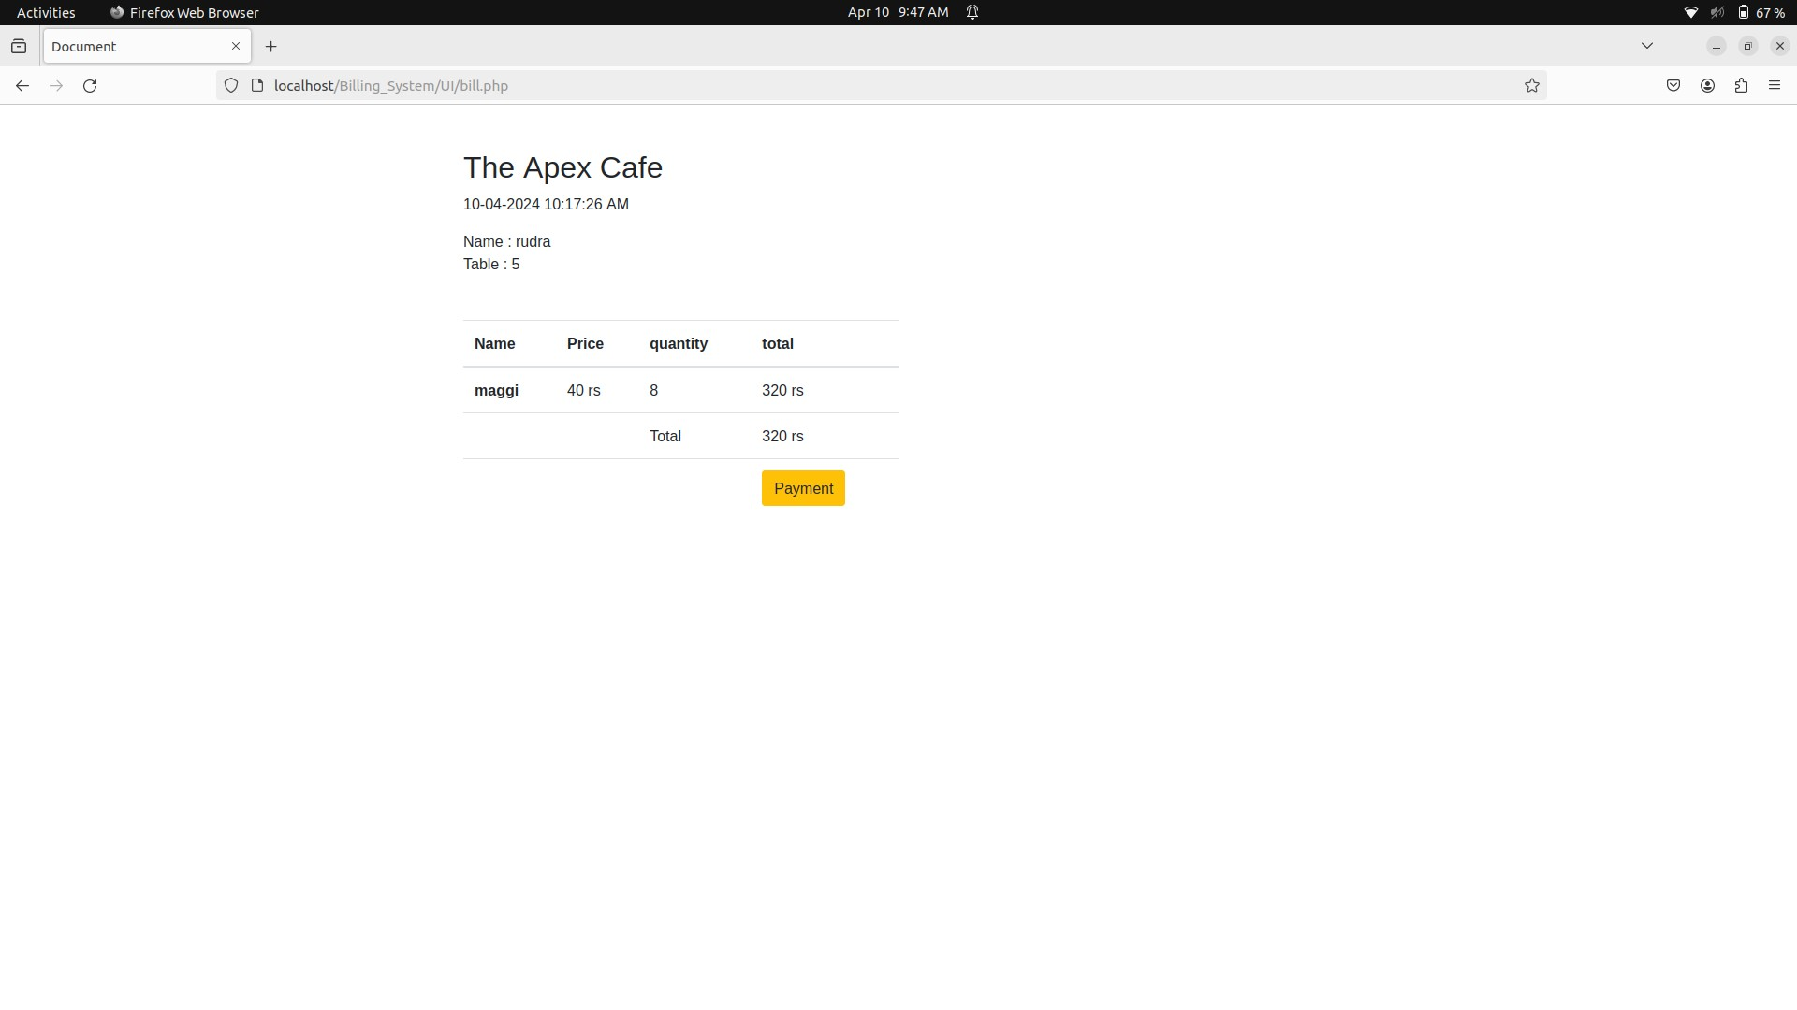
INPUTE & OUTPUTE SCREEN

Slide 21
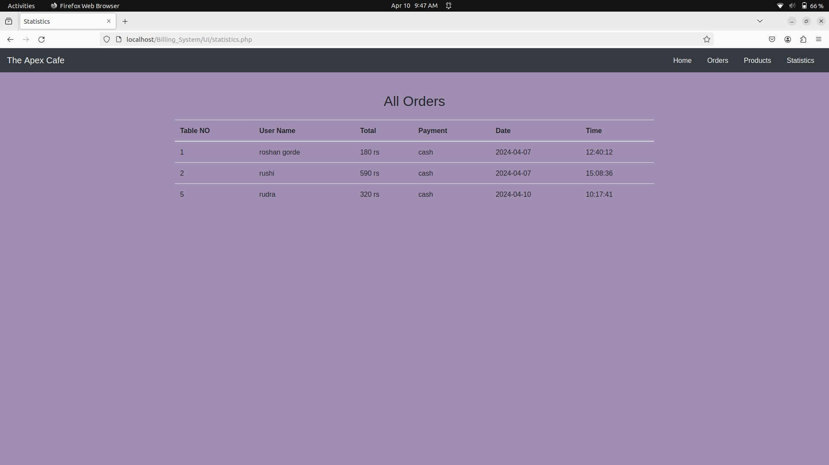
INPUTE & OUTPUTE SCREEN

Slide 22
Advantages
1.Efficiency Improvement:
Streamlines the billing process, reducing manual errors and enhancing overall operational efficiency in cafes.
2. Accurate Order Management:
Ensures accurate order processing, minimizing discrepancies and improving the accuracy of customer bills.
3. Customer Satisfaction:
Enhances the customer experience by reducing waiting times, providing clear and accurate billing information, and supporting diverse language preferences.
4. Real-time Synchronization:
Integrates with Point of Sale (POS) systems for real-time synchronization of orders, inventory, and sales data, providing up-to-date insights.

Slide 23
Disadvantages
1. Initial Cost and Implementation Time:
The upfront cost of acquiring and implementing a Café Billing System, along with the time required for staff training and system integration, can pose challenges.
2. Dependency on Technology:
The system's reliance on technology means that cafes may face disruptions if there are technical issues, system failures, or power outages.
3. Learning Curve for Staff:
Employees may experience a learning curve when adapting to new technology, potentially causing a temporary slowdown in operations during the transition period.
4. Maintenance and Updates:
Regular maintenance and updates are necessary to keep the system secure and up-to-date, requiring additional time and resources.

Slide 24
FUTURE ENHANCEMENT
1. Integration with Online Ordering Platforms:
Enable integration with popular online food ordering platforms to allow customers to place orders remotely. This feature can enhance customer convenience and expand the cafe's reach beyond its physical location.
2. Mobile App:
Develop a dedicated mobile app for the cafe billing system, providing customers with a seamless ordering and payment experience on their smartphones. The app can also offer loyalty rewards, personalized recommendations, and order tracking functionalities.
3. Inventory Management:
Enhance inventory management capabilities by implementing features such as automated reordering of
stock, real-time inventory tracking, and predictive analytics for demand forecasting. This can help optimize stock levels, reduce waste, and ensure availability of ingredients.
4. Customer Relationship Management (CRM):
Integrate CRM functionalities to better understand customer preferences, behavior, and feedback. This
can enable targeted marketing campaigns, personalized promotions, and improved customer retention
strategies.

Slide 25
Thanks you

